Slide 1

PRODUCTION FORECAST
by Eduardo Colmenares

Slide 2
FORECAST
* Data analysis
* Filter information
* Temporary series modeling
* Best models selection
* Production forecast

Slide 3

Business data
* CSV File
454.614 Lines
11 Columns
* Data from 2017
* Service details
Production data

Slide 4
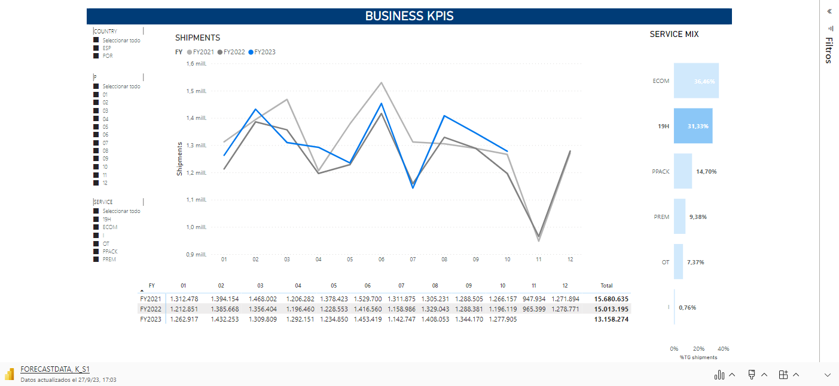
Business data

Slide 5

V
V
* Data analysis
Business information

Slide 6
* Data analysis
Focus in relevant information
V
V

Slide 7
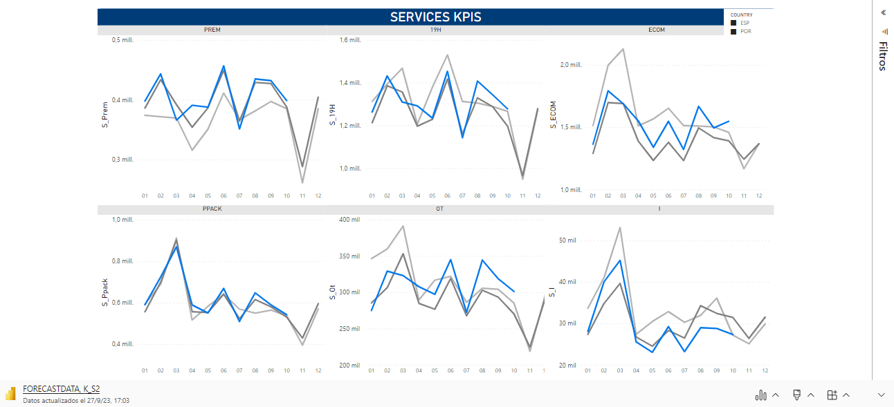
Filter and aggregate data

Slide 8

Temporary series modeling and best model selection

Slide 9
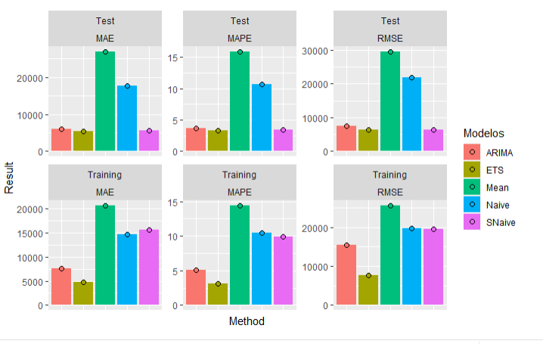
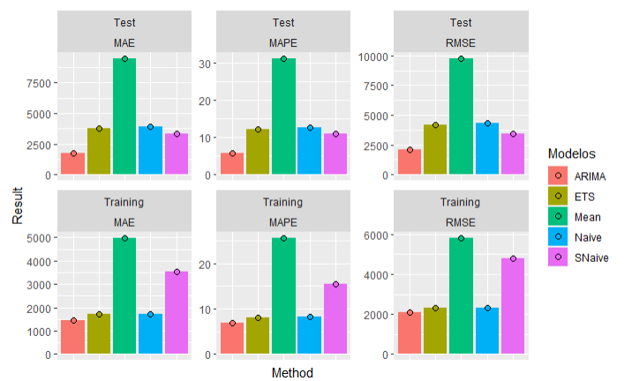
Model errors
Spain
Portugal

Slide 10

Best models
* ets
* auto.arima
* snaive

Slide 11
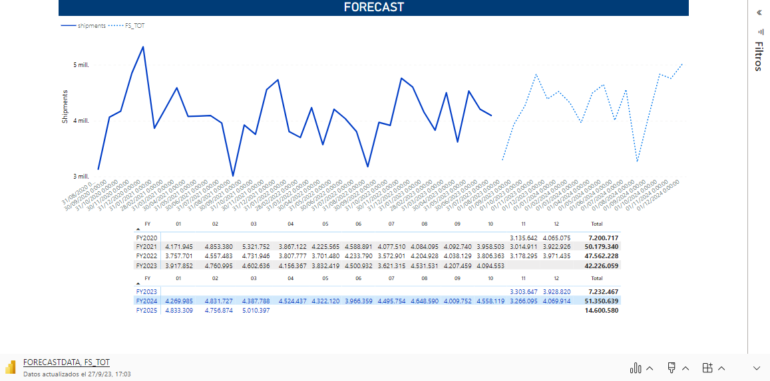
Forecast

Slide 12

Production forecast

Slide 13
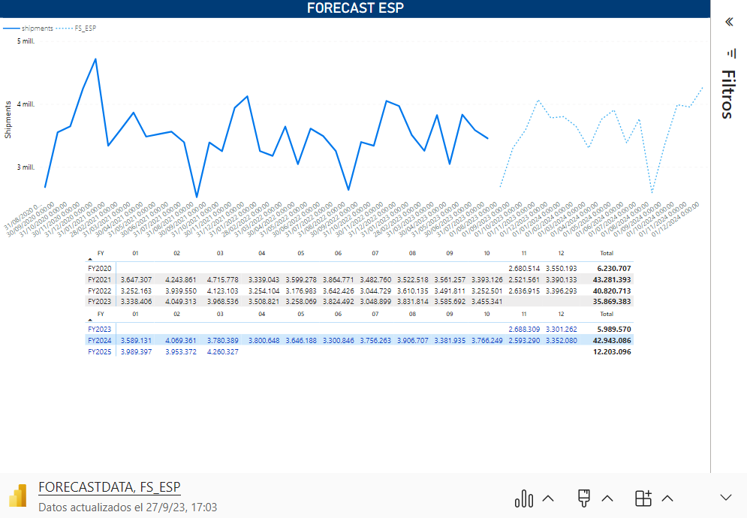
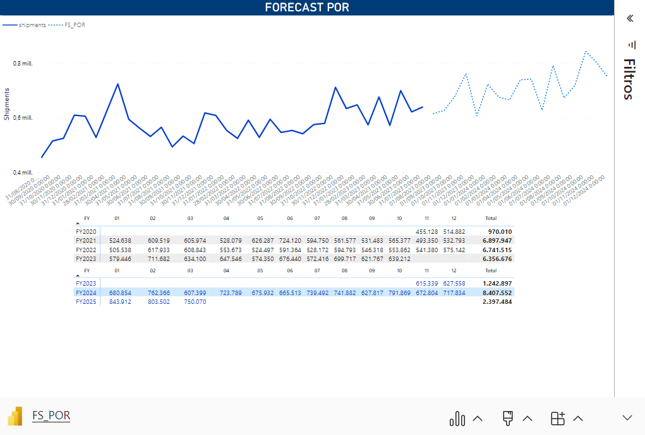

Slide 14
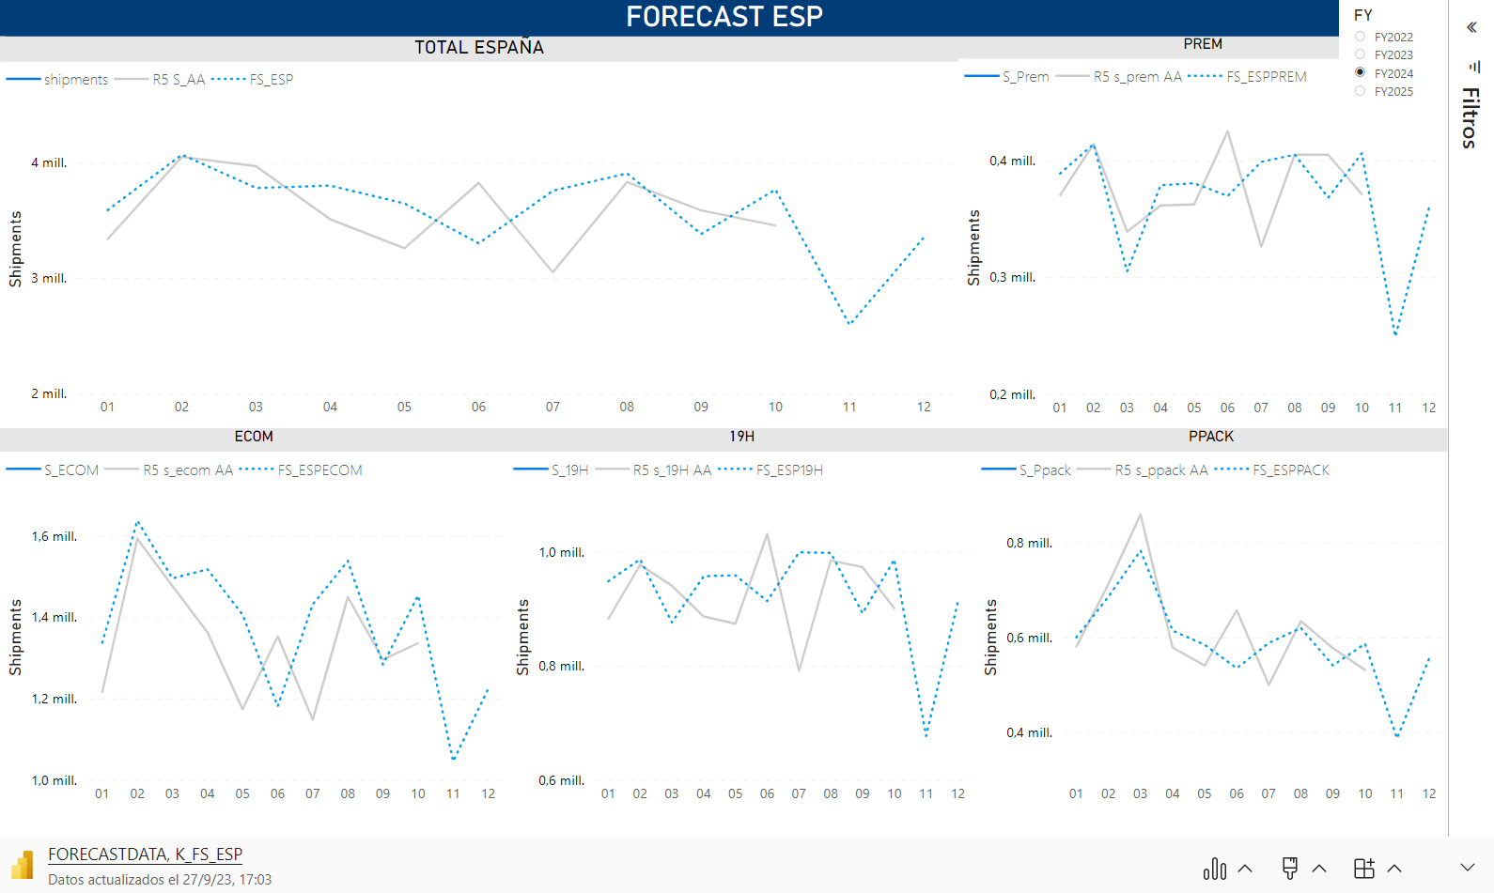

Slide 15
